Slide 1

Indoor Wi-Fi Locationing Study
IOT Analytics
Carlos Rivas

Slide 2

Problems and Goals
Problem: Our client is developing a system to help people navigate unfamiliar interiors (malls, universities, hospitals, etc) without getting lost, they have reached out to IOT Analytics to aid with this effort.
Goals: Develop a Machine Learning model that can help users determine were they are on unfamiliar interiors. We will be using Wi-Fi fingerprinting to help us with this effort, as satellite data is not as reliable for interior.

Slide 3

Data Description and Location
-The datasource that will be used for our project (UJIIndoorLoc) was developed with the goal of standardizing the practice of indoor location problems through the WLAN fingerprint-based method (also known as Wi-Fi Fingerprinting).
-The datasource was donated to our client by several points of contact from UJI (Universitat Jaume I) and UPV (Universitat Politecnica de Valencia).
- The location of were the datasource was collected is from UJI in the province of Castellon, Spain. It covers three of the buildings in the University, each with 4 or more floors. The data was created in 2013 by over 20 different users in 25 Android devices.
-Two databases will be used for the testing and validation, the training dataset (Which has 19937 records) and the validation dataset (which consists of 1111 records).
-The data does not have any missing values and it could be used as a regression or classification data

Slide 4
Data Description and Location (cont)
Both datasets have the same structure: 529 attributes that include:
-Wifi Fingerprint Data in the form of Wireless Access Points (WAPs) with their corresponding Signal Strength Intensity(520 attributes). This will be used as the independent variable to train our data.
-Coordinates which include Latitude and Longitude.
- Identifying features of the user location like Floor, Building ID, Space ID (which identifies the space (Ex: corridor, class, office), and Relative Position (which identifies if the user is inside or outside the front door)
-Other features like USER ID (for user who created the datapoint), Phone ID (of the user’s phone), and Timestamp.

Slide 5
Data Management for Project
Data in this project will go through rigorous management so it can better be used to accomplish our goal, data management will undergo the following process:
Preparing the right Environment for our Python Jupyter Notebook, we will use the following libraries: Pandas, Seaborn, Matplotlib, numpy, scipy, and sklearn
Importing and evaluating the Statistics of the data through Exploratory Data Analysis, summary statistics, and in-depth data analysis
Preprocessing of the data through feature selection, feature engineering, converting data types as needed, scaling, and anything else seen as needed to have a better model performance.
Train our different datasets (achieved through our different feature selection methods) and see what model/dataset combination gives us the best results. All this with our Train data. Models that will be used are: Random Forests, Decision Trees, KNN, and SVM
Evaluate the model selected with our Test data, make sure there is no overfitting and that the results are good enough when comparing our predictions to the ground truth
Use our model to predict the validation dataset, which will go through the same model, feature selection, scaling, feature engineering, etc as our training dataset

Slide 6
Known Issues with Data and Solutions
Issues:
There is no set single dependent variable, one will have to be engineered from our dataset in order to be the feature that will be predicted by our model
The dataset is very large and computational power might be limited in the current working environment.
Solutions:
We will be engineering a “Location ID” value based on the Building ID, Floor ID, and Space ID. This will help us have a more concrete value to predict, turing this project to a classification problem.
The dataset will be separated into a 70/30 training and testing data, this will reduce the amount of computational time. Additionally, through feature selection we will reduce the number of independent features in the dataset.

Slide 7
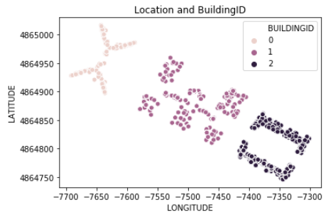
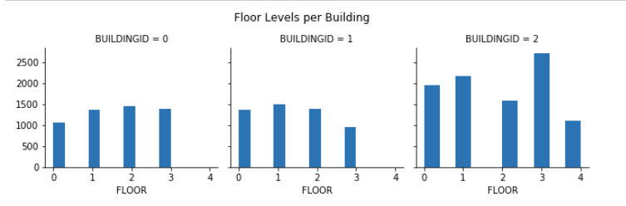
EDA
Our two charts here help us understand a bit more the structure of the location we are working with. The chart to the left was done with the help of LAT/LONG and the building ID features. It helps us better visualize better were the building are, how they compare to each other and a quick view of how many data points each building has. The second chart confirms that building 2 has the most data points while it also has one more floor than the other two buildings. Furthermore, we can see what Floors from what buildings have the least amount of data points. It makes sense that Building 2 has the most data points since it has an extra floor compared to the other buildings.

Slide 8
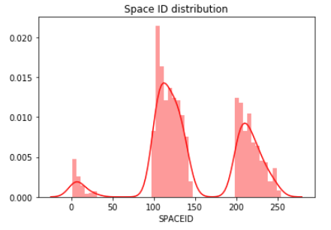
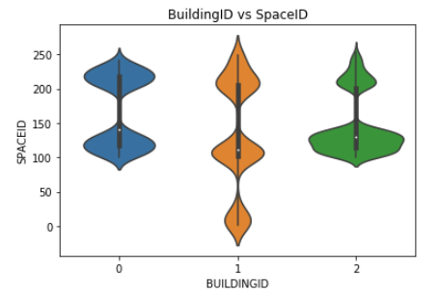
EDA (cont)
Since we are going to engineer a dependent feature (called LocationID) based on Building ID, Floor ID, and Space ID, it makes sense to look a bit deeper into the SpaceID feature. Here we can see a bit better that we don’t have 250 values from the Space ID like our min and max might have hinted we did. We see also that the Space ID values are not exclusive to each building, as we can see on the violin chart to the right, all Buildings have Space IDs with ID from 100-150, however we can also see that only Building 1 has the Space ID values below 50.

Slide 9
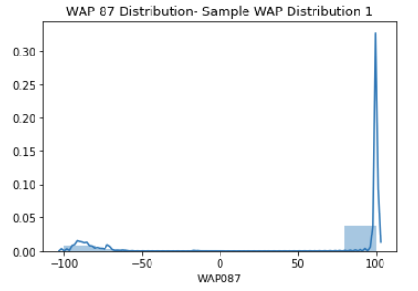
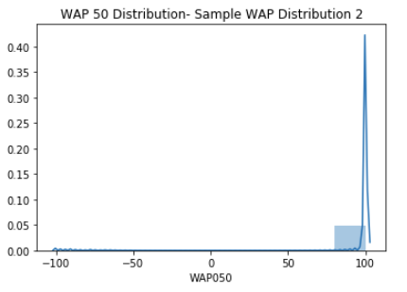
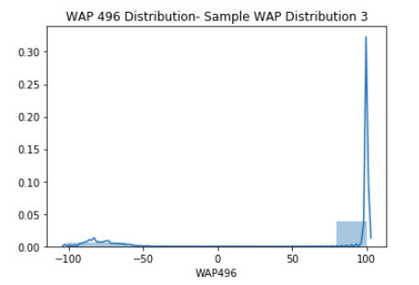
EDA (cont)
We will be using the WAP values as the independent values to predict LocationID. Here we have a sample of 3 of the 500+ WAP features. However, it is important to note, that most of the WAP values look more like Sample 2 (in the middle) which has little to no distribution. We will do feature selection methodologies such as no variance, and correlation to get rid of the redundant values. Also, important to note that value 100 means there is no signal, while the -100 to -50 means that there is singal. We will do processing to make 0 as no signal and 0-100 as weaker to stronger. Then we will scale our data so bigger numbers don’t affect our dataset too much.

Slide 10
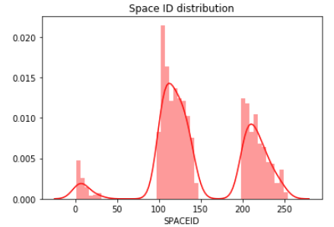
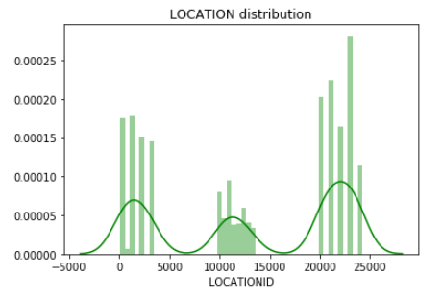
Feature Engineering
The value we will be predicting will be LOCATIONID, which is displayed in the chart above. This ID works the following way:
First Number: Number of the building
Second Number: Number of the Floor
Rest of the numbers: Numbers from the spaceID (to the right)
We can see to the right, the distribution of our dependent value, LOCATION ID. Since this is a classification model now, we will delete everything except the WAP values, which will be our independe values

Slide 11
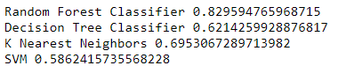
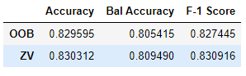
Model Selection
Out of the Box (OOB) dataset accuracies
Per Model
Best performing Feature Selection Filtered datasets with Random Forest
To select the best model, we first ran out 4 algorithms against the OOB dataset (OOB will include all WAP values, however it has all the features we don’t need such as PHONE ID removed). Our best model by far was Random Forest, therefore we will run that algorithm with our other filtered datasets. The best two performing datasets were the OOB and the no variance dataset (Which has the WAP values with no variance removed). As close as the results were, the Zero Variance dataset did perform a bit better. That means that our model will consist of Zero Variance filtering on the WAP values with Random Forest. After validating the model accuracy with our test data (which went through a 70/30 split), we are ready to predict our validation data.

Slide 12
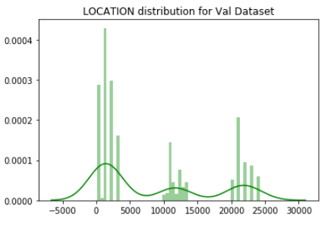
Predictions
As previously seen, in our training data we got around an 83% accuracy in our model (Which was later confirmed by the testing data). Here what we see now are the predictions based on a dataset that wet through the same preprocessing as our train data. We can see that most of our predictions are on Building 0, and we can also see that the structure of the floors is still the same as in our original EDA. This model aims to just be run once (Rather than having to run 3 times for floor, building, and spaceid), and compared to previous efforts it just does that with a better accuracy, which is excellent news.

Slide 13
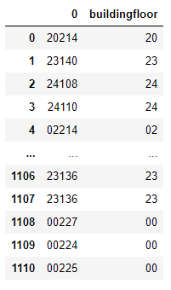
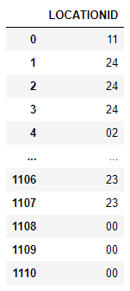
Predictions (cont)
Predictions Ground Truth
As an additional test, we realized that the validation set actually contains the Building and Floor IDs. This means we can compare how our model predicted Building ID and Floor ID and see an accuracy of sorts. Our model actually aims at predicting Building ID, Floor ID AND Space ID. However, the validation dataset does not have Space ID, therefore we cannot get the whole accuracy. That being said, our model gave us great results for the first two features with a 90% accuracy, giving us confidence that our model is working right and most likely also predicted SPACE ID correctly.

Slide 14
Model Recommendation
As shown on our presentation, the model recommendation for this scenario will follow the following guidelines:
- Filter all WAP values with zero variance
- Re-order the WAP values so 100 becomes 0 and lowest to highest WAP signal go from 1 to 104
-Scale WAP values so higher values won’t affect the model more than the lower values
-Use Random Forests as the algorithm to predict the LOCATION ID
This model has been packaged in a Jupyter Notebook by IOT Analytics, and is ready for deployment

Slide 15
Future Improvements
-Further Optimize the Random Forest parameters in order to get better predictions. This might need more computer power than currently available or more time.
-Keep collecting data in the same format, but in new indoor locations. This will serve as a proof of concept, as currently our dataset has only been tested in Universitat Jaume I. This will be valuable in places like hotels were we can really test the Floor prediction
-Create a global dataset (once the app is created) were users can serve as new data points, getting more data and further improving the model.

Slide 16

Thank you

